Slide 1
Opera & musical theatre:
Performing Alexander Hamilton

Slide 2
What is the show all about?
Alexander Hamilton was one of America’s Founding Fathers
American Revolution: the Thirteen Colonies fought for independence from Great Britain
Declaration of Independence 4th July 1776
George Washington: first President of the United States
Hamilton was Washington’s treasury secretary
He was killed in a duel by his rival Aaron Burr

Slide 3
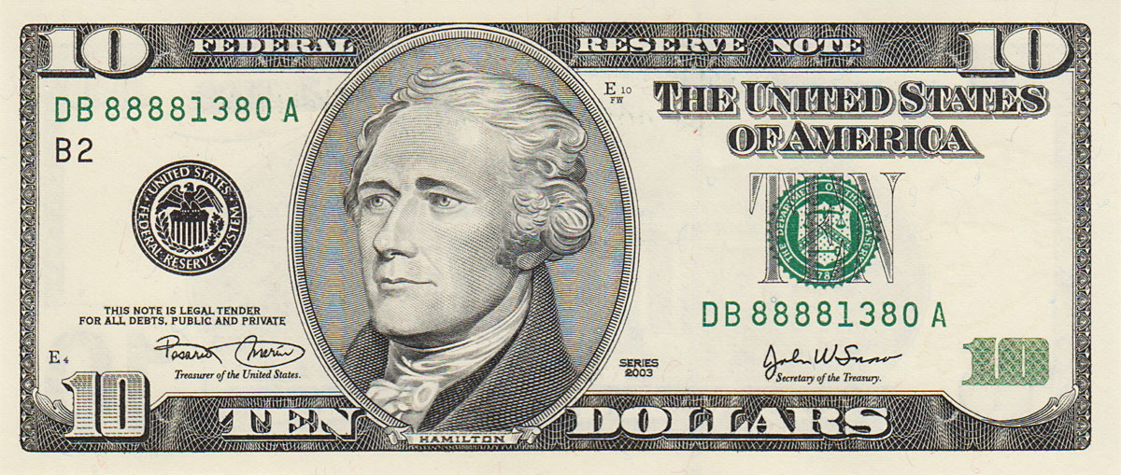
Hamilton is now pictured on the $10 note

Slide 4
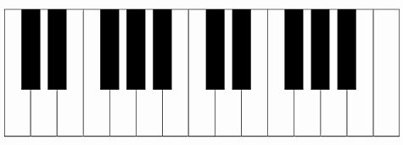
Chord progression 1:
Bm
F#
G
D
F#/A#
Keys
Bass

Slide 5
Chord progression 2 ‘IN NEW YORK YOU CAN BE A NEW MAN’:
Bm
G7
Em
F#^{sus}
F#/A#
Keys
Bass

Slide 6
The ascending bass line (2 beats per chord)
Bm/D
Em
Bm/F#
Em/G
D/A
F#/A#
How does it feel played backwards?
Bm
Bm/C#
Bm/D
Em7
Em/G

Slide 7
INTRO

Slide 8
AARON BURR: How does a bastard, orphan, son of a whore And a Scotsman, dropped in the middle of a forgotten spot in the Caribbean by providence impoverished, In squalor, grow up to be a hero and a scholar?
BASS NOTES ONLY
Click on 2 and 4
Bm
F#
G
D
F#/A#

Slide 9
LAURENS: The ten-dollar founding father without a father Got a lot farther by working a lot harder By being a lot smarter By being a self-starter By fourteen, they placed him in charge of a trading charter
BASS NOTES ONLY
Click on 2 and 4
Bm
F#
G
D
F#/A#

Slide 10
THOMAS JEFFERSON: And every day while slaves were being slaughtered and carted away Across the waves, he struggled and kept his guard up Inside, he was longing for something to be a part of The brother was ready to beg, steal, borrow, or barter
BAB__________
F#EF#________
GAG__________
Bm
F#
G
D
F#/A#

Slide 11
MADISON: Then a hurricane came, and devastation reigned Our man saw his future drip, dripping down the drain Put a pencil to his temple, connected it to his brain And he wrote his first refrain, a testament to his pain
BAB__________
F#EF#________
GAG__________
Bm
F#
G
D
F#/A#

Slide 12
AARON BURR: Well, the word got around, they said, this kid is insane, man Took up a collection just to send him to the mainland Get your education, don’t forget from whence you came And the world is gonna know your name What’s your name, man?
etc.
Bm
F#
G
D
F#/A#
Keys

Slide 13
ALEXANDER HAMILTON: Alexander Hamilton My name is Alexander Hamilton And there’s a million things I haven’t done But just you wait, just you wait
etc.
Bm
F#
G
D
F#/A#
Keys

Slide 14
ELIZA HAMILTON: When he was ten his father split, full of it, debt-ridden Two years later, see Alex and his mother bed-ridden Half-dead sittin' in their own sick, the scent thick ALL (N.C): And Alex got better but his mother went quick
etc.
Bm
F#
G
Keys

Slide 15
GEORGE WASHINGTON: Moved in with a cousin, the cousin committed suicide Left him with nothin' but ruined pride, something new inside, a voice saying ALL: Alex, you gotta fend for yourself He started retreatin' and readin' every treatise on the shelf
1
2
3
etc.
Bm
F#
G
D
F#/A#
Keys

Slide 16
AARON BURR: There would have been nothin' left to do for someone less astute He woulda been dead or destitute without a cent of restitution Started workin', clerkin' for his late mother’s landlord Tradin' sugar cane and rum and all the things he can’t afford
STAB CHORDS
Bm
F#
G
D
F#/A#
Keys

Slide 17
Scammin' for every book he can get his hands on Plannin' for the future see him now as he stands on the bow of a ship headed for a new land - in New York you can be a new man
1
2
3
Bm
F#
G
D
F#/A#
Keys

Slide 18
ALL: In New York you can be a new man In New York you can be a new man In New York you can be a new man In New York you can be a new man HAMILTON: Just you wait
NEW CHORD PROGRESSION
Keys
Bm
G7
Em
F#^{sus}
F#/A#

Slide 19
ALL: Alexander Hamilton We are waiting in the wings for you You could never back down You never learned to take your time
Keys
Bm
G7
Em
F#^{sus}
F#/A#

Slide 20
ALL: Oh, Alexander Hamilton When America sings for you Will they know what you overcame? Will they know you rewrote your game?
Ascending bass line starts
etc.
Keys
Bm/D
Em
Bm
G7
Em

Slide 21
The world will never be the same, oh
NEW CHORD PROGRESSION
etc.
Bm/F#
Em/G
D/A
F#/A#
Ascending bass line continues

Slide 22
AARON BURR: The ship is in the harbour now See if you can spot him Another immigrant comin' up from the bottom His enemies destroyed his rep America forgot him
NEW CHORD PROGRESSION
etc.
Bm
Bm/C#
Bm/D
Em7
Em/G
Em/C#
Ascending bass line continues

Slide 23
MADISON/LAFAYETTE/JEFFERSON: We fought with him LAURENS/PHILIP: Me, I died for him WASHINGTON: Me, I trusted him ELIZA/ANGELICA/MARIA: Me, I loved him AARON BURR: And me, I’m the damn fool that shot him
x4
F#sus
F#
Em/C#

Slide 24
ALL: There’s a million things I haven’t done But just you wait AARON BURR: What’s your name, man? ALL: Alexander Hamilton!
Em/G
D
Em/F#
F#7
Bm
1 + 2 + 3

